Slide 1
Autograder
( Asynchronous grading Architecture )
Team Member
Vedant Goswami ( 23M0766 )
Saurav Chaudhary ( 23M0838 )

Slide 2
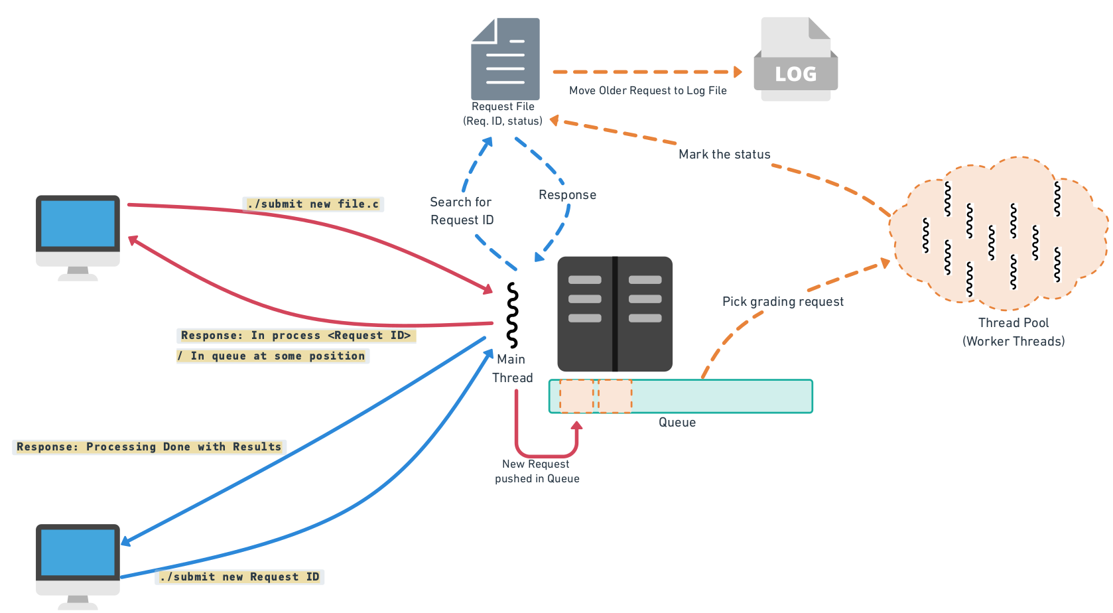

Slide 3
Details
As soon as server receives grading request from the client, it create a socket for the client. The main thread receives initial message from the client as REQUEST / GRADE .
If the message is GRADE then assign a request id and send the request to the queue and send the response to the client as “Your grading request ID <requestID> has been accepted and is currently being processed.”
If the message is 'REQUEST', the main thread will first check the queue. If the request is found in the queue, the response sent to the client will be: “Your grading request has been accepted and is located at position <position> in the queue.” If the request is not found in the queue, the main thread will then search for the request in the request file using the request ID provided by the client. The main thread will send the status along with the results. If the requested ID corresponds to an older entry, it will be retrieved from the Log file.

Slide 4
Once a worker thread picks the request from the queue, it will create a entry in the request file with current time as timestamp. This timestamp will help to move the older request to the log file.
Worker thread completing the grading request will update the status and picks the next request or will go to sleep.
For every request id we have to create error file (error_<request_id>.txt), output file (output_<request_id>.txt), so that each client’s result doesn’t overlap.

Slide 5
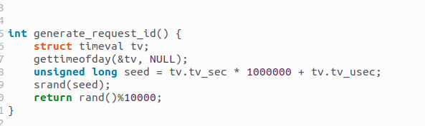
Request ID Generation

Slide 6
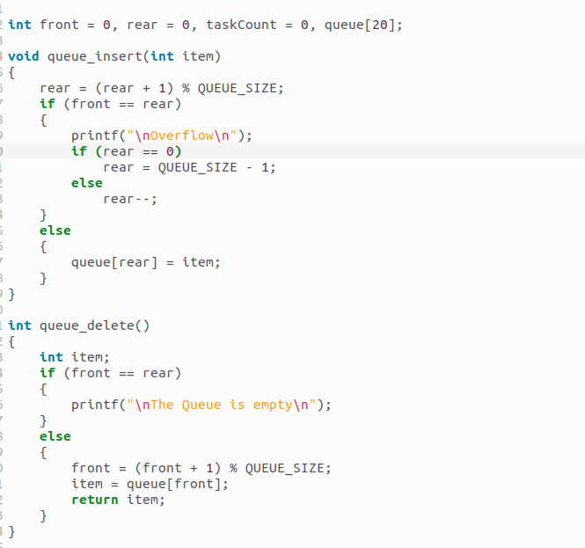
Queue Structure

Slide 7
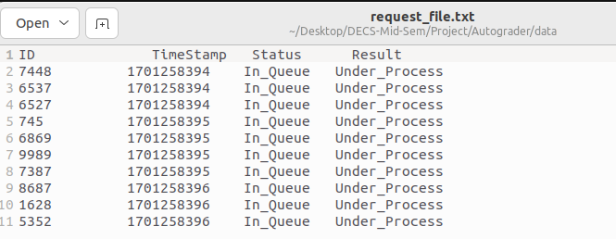
Request Mapping

Slide 8
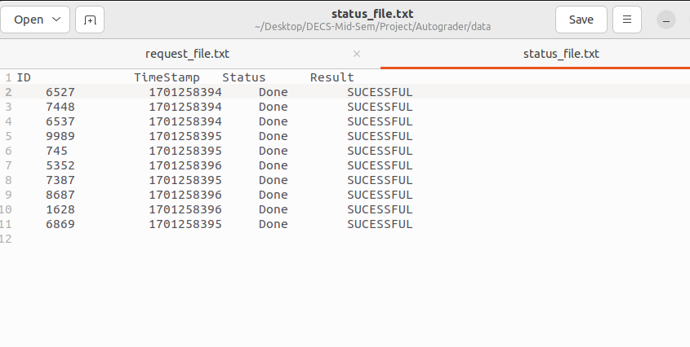
Design For Storing Result

Slide 9
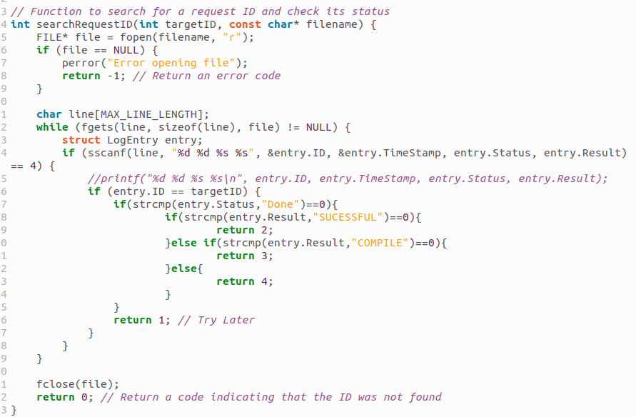
Design For Sending Result

Slide 10
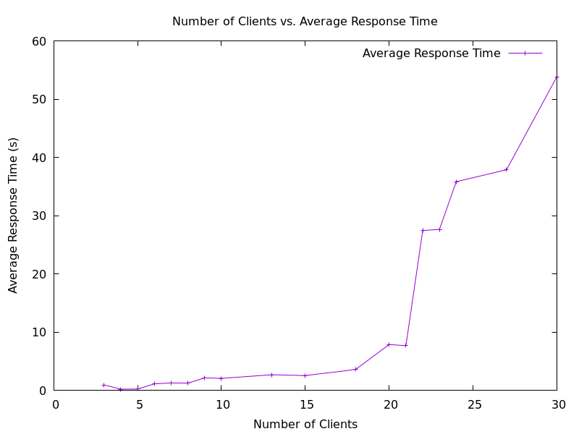
Response Time

Slide 11
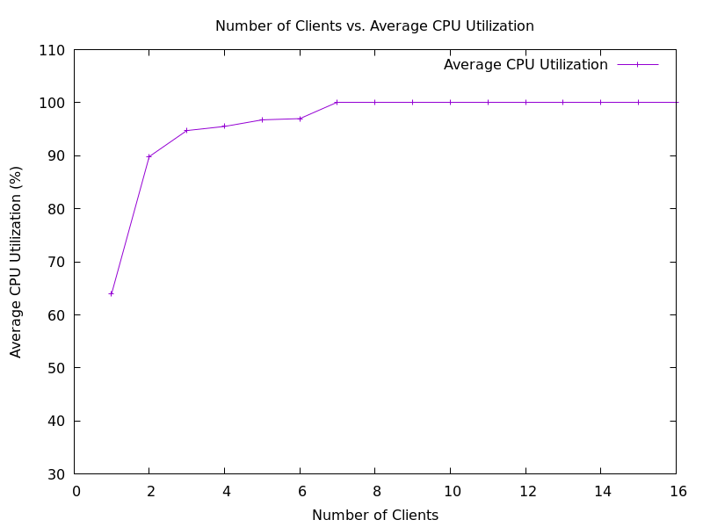
CPU-Utilization

Slide 12
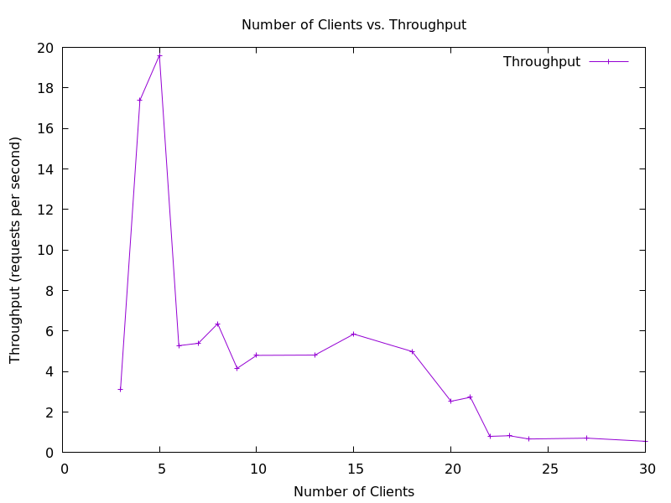
Throughput

